Slide 1


Slide 2


Stock Price Prediction
Presented by: Nguyễn Minh Cường
Nguyễn Tùng Phong
Ngô Trung Dũng
Nguyễn Việt Long
Đặng Kiều Trinh
Nguyễn Phan Anh Vũ

Slide 3

Presentation Outline
Introduction
Data preparation
Method
Statistical method
Machine learning method
Result
Conclusion
Future Work
4

Slide 4

1. Introduction
Vietnamese stock market has substantial growth, increased in investor
Predicting stock price is complex, challenging, valuable
Our project using time series forecasting and machine learning techniques
Goals :
Develop different models
Preprocess data and engineer relevant features
Evaluate the model and compare
Provide insights and recommendations
5

Slide 5


2. Data preparation
6

Slide 6
Data collection
From https://investing.com
Target variable: Close Price ( USD)
Dataset consist of 7 attributes: Trading date, Open, High, Low, Close, Adj Close and Volume
6

Slide 7
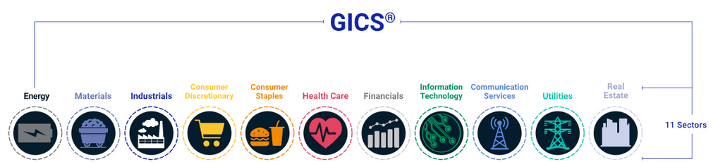
Data Collection
Random selection : No meaningful insights
GICS is an industry analysis framework, helps investors understand company’s activities
HPG
CTG
GAS
Criteria: Largest market capitalization in HOSE
6

Slide 8
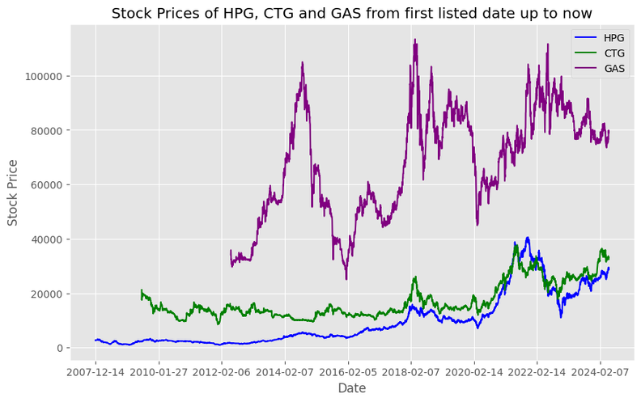
Data analysis
2008-2009: Financial Crisis
Decline
2012-2015: Economic Growth
Stable and gradual increase
2016-2020:US-China trade war, uncertainty global markets
Fluctuation
2020-2022: Covid-19 Pandemic
Decrease and recover
6

Slide 9

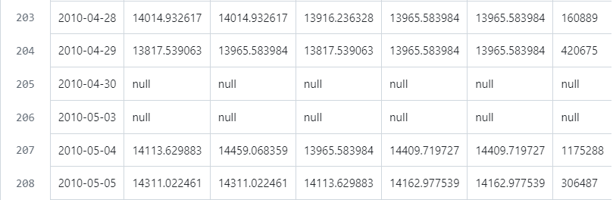
Data preprocessing and feature selection
Remove gaps in data (holidays, weekends, error from data source website)
7

Slide 10
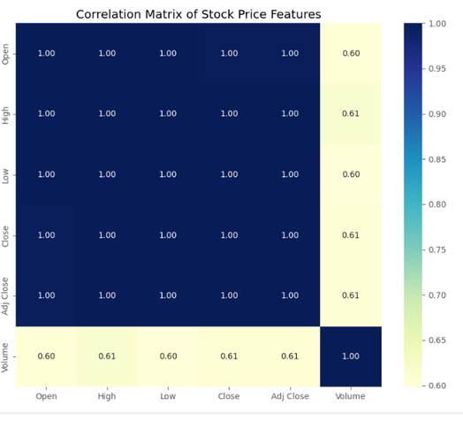
Data preprocessing and feature selection
The stock price metrics (Open, High, Low, Close, Adj Close) show high intercorrelation.
Trading volume is positively correlated with stock prices (not as strong).
Suggests that trading volume is influenced by additional factors beyond just price movements.
7

Slide 11


3. Method
9

Slide 12

Statistical method (ARIMA)
ARIMA : AutoRegressive Integrated Moving Average
Consist of three components - 3 parameters
AutoRegressive (p):
Integrated (d)
Moving Average (q)
Forcast:
Stationary time series
Non-stationary times series - can be made stationary
10

Slide 13

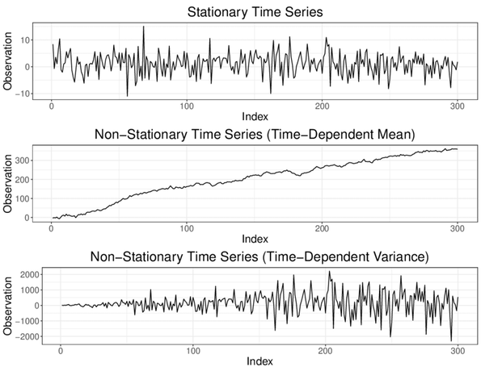
Stationarity
Stationary: constant mean, constant variance, constant covariance.
No trend, no seasonal pattern.
Stationary is crucial
It ensures statistical behavior doesn’t change over time
Need test for stationary:
By visual
By statistic test
10

Slide 14
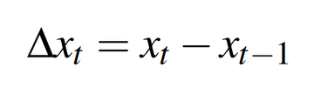
Augmented Dickey-Fuller
Testing the presence of unit root
Procedure:
Fitting a regression model
Computing test statistic
Comparing p-value < 0.05 means reject the presence of unit root -> stationary
If not stationary, we do Differencing (d) . If the first differencing does not achieve stationarity, do more differencing until achieved.
Example: first difference
10

Slide 15

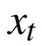
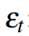
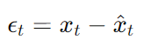
AR and MA
Mathematical representation of the AR and MA component
AR component
MA component
: value(stock price) at time t
: error term at time t
Have to choose p, q
Perform grid search for different p’s and q’s with respect to AIC (Akaike Information Criterion) .
Lower AIC values often means better model
10

Slide 16

Overall process of ARIMA
Split data into train/test set
Scale data
Check stationary
Find best (p,d,q) parameter
By plotting
By ADF test
Update the true observation of that day
Forecast the next day
Predict the train set
Fit the model
Test set
Fit the model
Evaluation
10

Slide 17

Ridge Regression
Ridge Regression is used for linear regression models with multicollinearity.
Problem: Multicollinearity causes unbiased least squares estimates to have large variances, making the model overfit the training data.
Solution: Ridge Regression adds bias to reduce standard errors, creating a more reliable model.
11

Slide 18
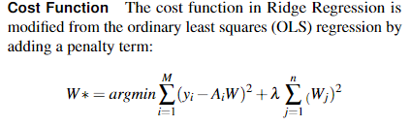
Ridge Regression
λ is the regularization parameter, which controls the strength of the penalty term
When λ= 0, it's equivalent to OLS regression.
11

Slide 19
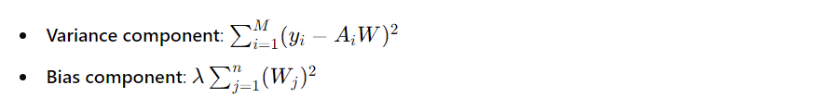
Ridge Regression
Bias-Variance Tradeoff
Bias: The difference between the model's predictions and the actual values. High-bias models (large λ) are simple and underfit the training data.
Variance: The model's sensitivity to training data fluctuations. High-variance models (small λ) are complex and overfit the training data.
Balancing λ is crucial for optimal model performance.
11

Slide 20
Ridge Regression
Advantages
Handles multicollinearity by shrinking coefficients.
Reduces overfitting with a penalty on coefficients.
Simple to implement.
Disadvantages
Does not remove unimportant features.
Coefficients can be difficult to interpret.
Performance depends heavily on the choice of λ.
11

Slide 21
Ridge Regression
Improving Accuracy
Outlier Removal:
Create bounds for the 'Close' column.
Remove data outside the bounds to reduce complexity.
GridSearchCV:
Test Ridge Regression with different λ values.
Evaluate using cross-validation to find the optimal λ.
11

Slide 22
SVR - Support Vector Regression
SVR:
Supervised learning algorithm based on SVM
Used for predicting continuous output variables by finding a hyperplane in an n-dimensional space best fits the data
Minimizing error within a specified margin of tolerance.
This margin is controlled by two parameters: epsilon (ε) and C.
10

Slide 23
SVR Hyperparameters
SVR includes several parameters that significantly impact model performance. The key parameters to tune are:
Kernel Function
Regularization parameter (C)
Epsilon (ε)
Gamma (γ)
To improve the accuracy of our SVR model, we tried these strategies:
Hyperparameter tuning
Feature Scaling
Cross-Validation
Kernel Selection
10

Slide 24
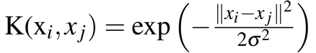
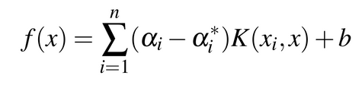
Algorithm
The SVR algorithm aims to find a function f (x) that has at most ε deviation from the actual targets for all training data points, while also ensuring that the function is as flat as possible.
Input:
• A set of n examples forming the Training Set.
TSn ={(x1,y1),(x2,y2),...,(xn,yn)}
• A kernel function K(xi,xj). ( We used the RBF function )
• Regularization parameter C. ( 1000 )
• Epsilon parameter ε. ( 0.01 )
• Gamma parameter γ ( 0.001 )
Initialize: Compute the kernel matrix K using the chosen kernel function.
Prediction: For a new data point x:
Where b is determined from the support vectors
10

Slide 25
Random Forest
Random Forest is an ensemble machine learning method involves in constructing multiple Decision Trees during training using random subsets of datasets and feature for each tree.
Decision Trees work by recursively splitting the input space based on feature values to minimize impurity or maximize information gain, but they can be overfitting, especially with complex or noisy data.
↳ Introduce Bagging (also known as Bootstrap Aggregation) to boost the model accuracy and avoid overfitting by combining multiple models. These model's predictions are then combined through averaging which resulting in a more robust and accurate final model.
11

Slide 26
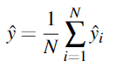
Random Forest
Bagging formula:
To further increase accuracy of the model:
Tuning hyperparameter: the optimial maximum depth, maximum features, number of trees, and minimum number of features in each node is found by performing Grid Search.
Using cross-validation: use 5-fold cross-validation to provide a better overall model’s accuracy in predictions while avoid overfitting.
12

Slide 27
AdaBoost
AdaBoost ( Adaptive Boosting) a machine learning algorithm mainly used for classification task, but can also be adapted for regression.
Gradient Boosted Decision Trees (GBDT) is widely used for regression. This method iteratively combines multiple decision trees to improve predictions by reducing residual errors from previous iterations
Essentials elements including:
Learning rate: lower learning rate slows the algorithm's progress, but potentially leading to better performance.
Weak learner selection: typically a shallow decision tree to avoid overfitting.
11

Slide 28
AdaBoost
Residuals and Gradient Descent: each iteration involves fitting a weak learner to the residuals (the differences between actual and predicted values) using gradient descent to minimize a loss function, such as mean squared error. The weak learner is then added to the ensemble, and the process is repeated iteratively.
Ensemble Combination: the model's final prediction is the sum of all weak learners' predictions, with weights determined by the learning rate.
11

Slide 29
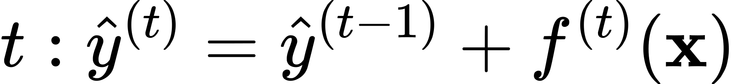
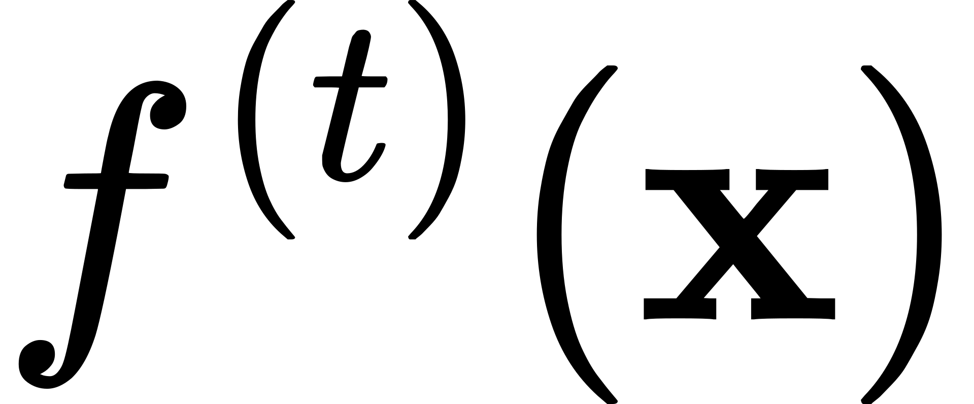

XGBoost
What is XGBoost?
XGBoost stands for "eXtreme Gradient Boosting"
Optimized implementation of the gradient boosting machine learning algorithm
Ensemble of decision trees trained sequentially to correct errors of previous trees
Additive Training
Prediction at step
is new tree added to correct errors
Objective is to find that minimizes overall loss
11

Slide 30
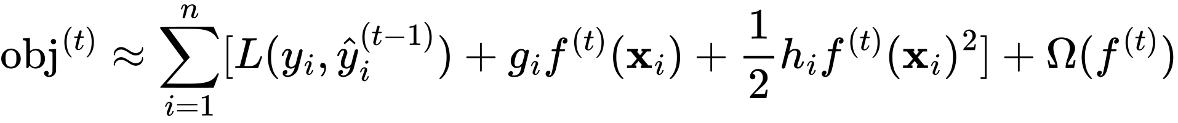
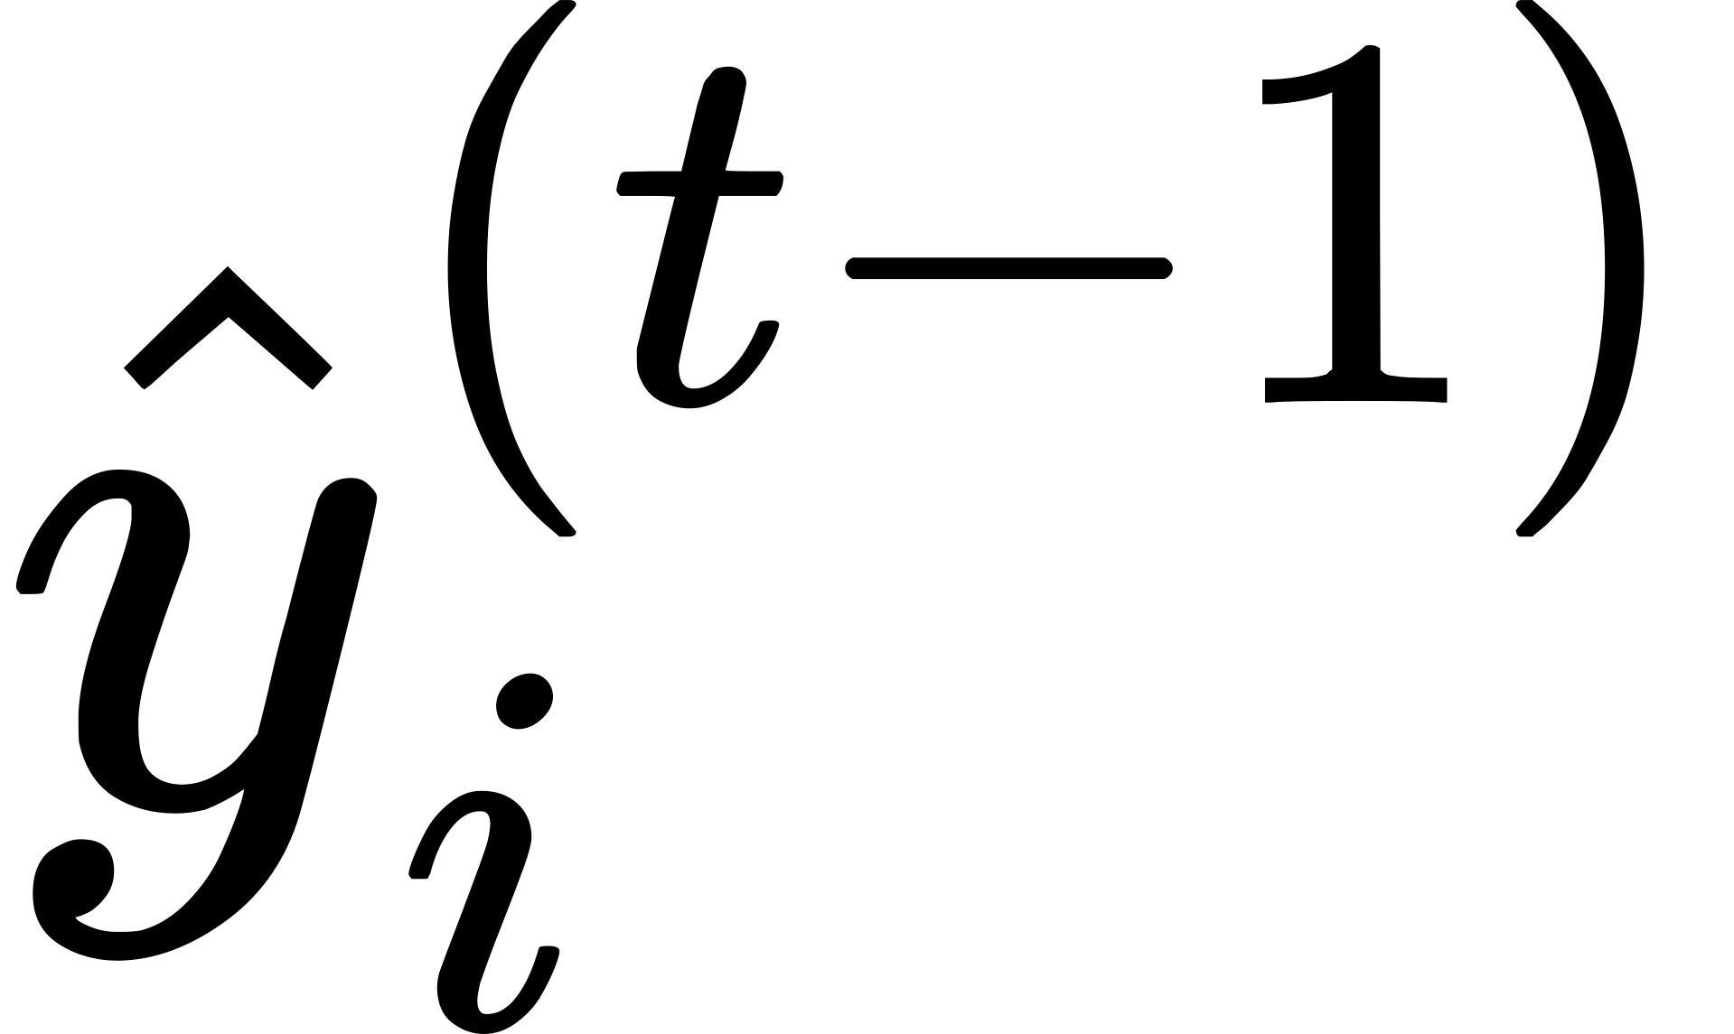
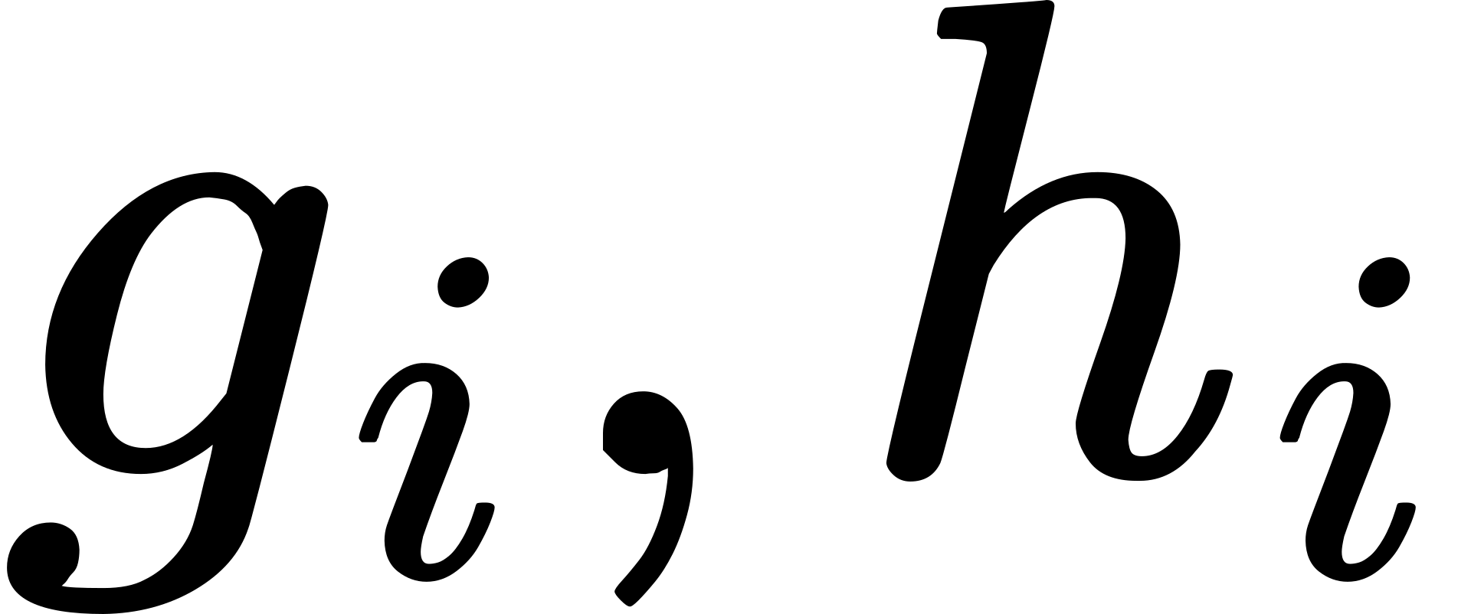
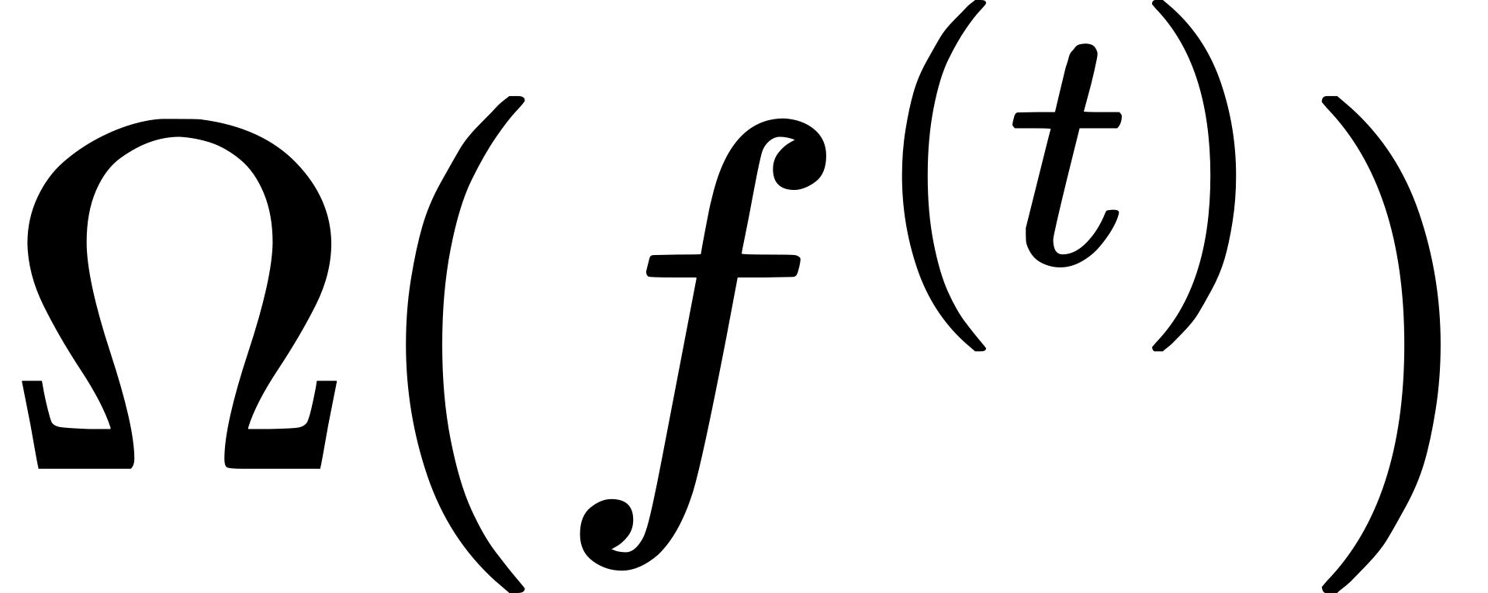
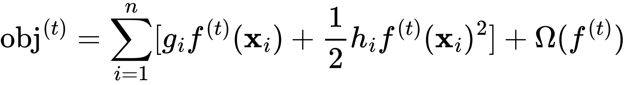
XGBoost
Gradient Boosting
Approximates the loss function using 2nd order Taylor expansion:
: 1st and 2nd order gradients of loss function
: regularization term to penalize tree complexity
Rearrange to get simplified objective:
Find optimal by minimizing simplified objective
11

Slide 31
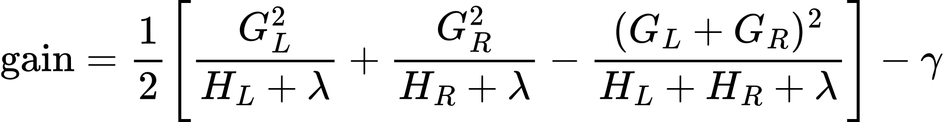
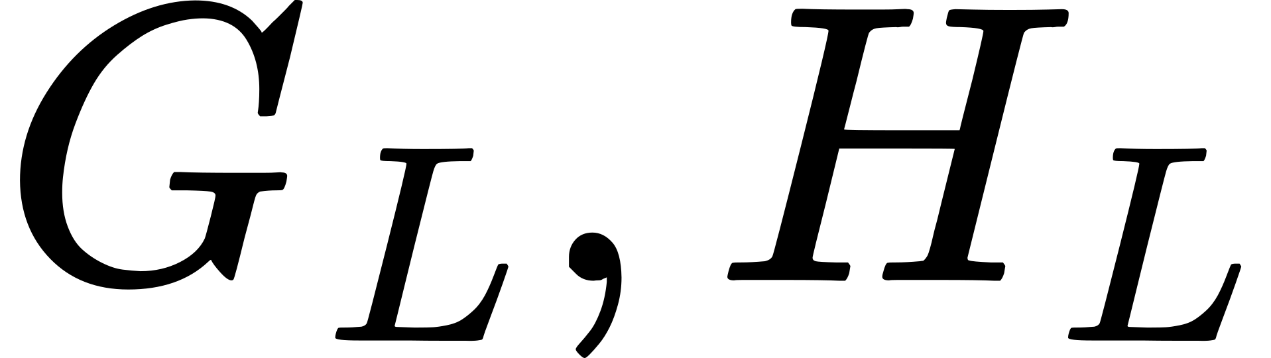
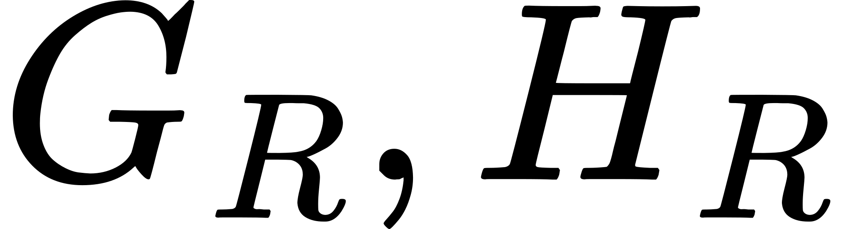



XGBoost
Tree Structure Optimization
Selects split points that maximize gain
Gain measures the reduction in loss from introducing a split
Defined as:
: sum of 1st and 2nd order gradients in left leaf
: sum of 1st and 2nd order gradients in right leaf
: L2 regularization term on leaf weights
: minimum loss reduction required for a split
Penalizes leaf complexity to prevent overfitting
Regularization Techniques
Shrinkage (Learning Rate):
Scales the contribution of each new tree by a factor
Slows down the learning to prevent overfitting
Column Subsampling:
Each tree is trained on a random subset of features
Reduces correlation between trees and increases robustness
11

Slide 32
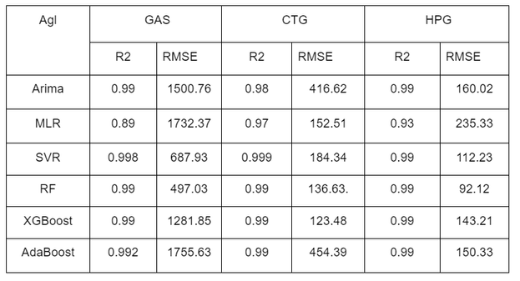
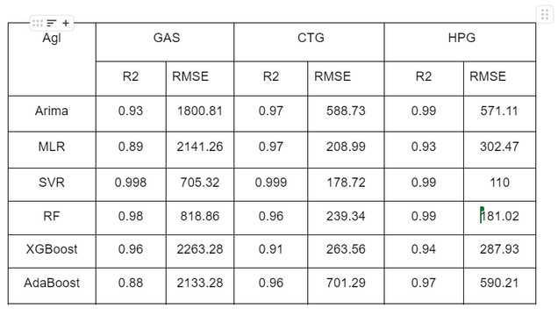
4. Result
Train set results
Test set results
Shows acceptable performance in predicting stock prices
Provides valuable insight into market trends when considering stable policy environments.
However, sudden policy shifts(Ex: national bankruptcies or stock takeovers) can significantly impact the model’s accuracy
11

Slide 33
5. Future Work
Try to: ...
Develop methods to integrate sudden policy shifts and market events into the model
Optimize parameter tuning techniques
Improve feature engineering by incorporating more data sources and advanced technical indicators
Develop a platform accessible to users
12

Slide 34

THANK YOU !
13

